Slide 1
Sentiment Analysis of Sandisk Ultra’s Amazon Reviews (Natural Language Processing)
Emine Erdogan
Springboard, 2023

Slide 2
AGENDA
Introduction
Dataset
Data Wrangling
Exploratory Data Analysis
Models
Hyperparameter Tuning
Conclusion

Slide 3
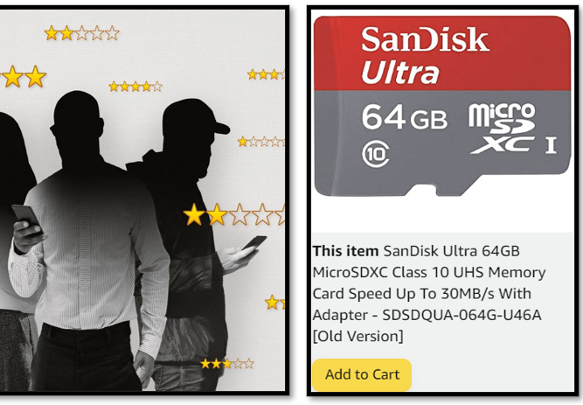
INTRODUCTION
Amazon Reviews
SanDisk
Sentiment Analysis
A reputable digital storage technology company, a leading brand of memory cards.
Well-regarded by both customers and professionals who are interested in photography and video recording.
Goal:
to determine the sentiment of a piece of text, whether it expresses positive or negative emotion or thought.
Notes:
user reviews are one of the most effective methods to buy a product, or not. These reviews can both give an idea to customers and be feedback for manufacturers since the reviews show the positive sides and the sides to be improved

Slide 4
PRIMARY GOALS
To acquire reviews on SanDisk memory card from Kaggle.com.
To preprocess the data by removing irrelevant information.
Sentiment analysis using a supervised machine learning approach.
Evaluate the performance of different machine learning algorithms.
To provide insights

Slide 5
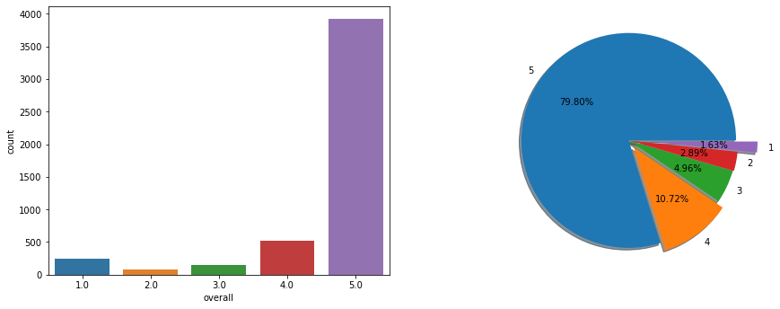
Dataset
4915 unique customers reviews
01/09/2012 - 12/07/2014
11 columns
Reviewer ID
Asin (product ID)
Reviewer name
Helpful
Review Text
Overall
Summary
Unix Review Time
Review time
Day difference
Total vote

Slide 6
Data Cleaning/Wrangling
‘unix review time’, ‘reviewer names’, ‘asin (product id)’, and ‘helpful_yes’ columns are dropped.
Not to have a measurement problem in our analysis, we removed the followings using re library
Punctuations
Numbers
Rare words
Stop words
Tokenization (splitting up a larger body of text into smaller lines, words)
Lemmitization (reduced the words into their roots )

Slide 7
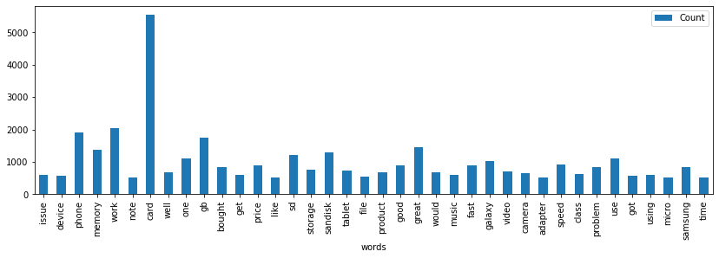
Word count

Slide 8
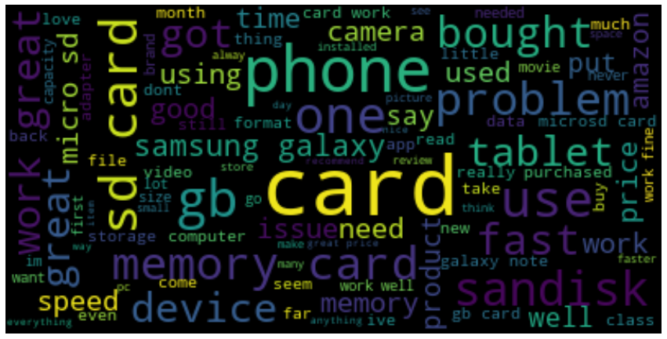
Word cloud

Slide 9
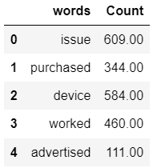
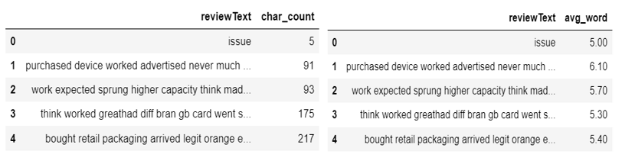
Descriptives

Slide 10
Sentiment Analysis
Polarity Scores
- Polarity scores are created for every word in every review
- A compound value is created for each review.
- A sentiment label column was created
Unbalance Data
- 3946 positive (80.2%)
- 969 negative (19.8) reviews.
- Attentions to the metrics
- Precision score ➔ false positives
Average (mean)
- Reviews are grouped by overall ratings
- Almost equal average scores of positive and negative comments (4.09/4.71).
- Transformed the sentiments to numbers using Label encoder
- Created a new column
Label Encoder

Slide 11
Modeling
Data Splitting
Final data contains only review text and their sentiment labels.
Split the data:
X :review text
y : Sentiment Labels
Count Vectorizer
Transform the review texts into a matrix of token counts (for TF)
n-grams ➔ both unigrams (=single word) and bigrams (=combination of two words)
TF-IDF
Convert the count matrix into normalized TF-IDF representation.
Standardize the data and to eliminate potential biases created by count vectorizer method.
Create the Pipeline class from the scikit-learn library
- Stochastic Gradient Descent (Linear Support Vector Machine)
- Random Forests
- Logistic Regression
- Naïve Bayes
Model Pipeline

Slide 12


Model Performance
SGD Classifier
Precision Score
0.87
Winner Model
Random Forest
Precision Score
.83
Logistic Regression
Precision Score
0.81
Naïve Bayes
Precision Score
0.80

Slide 13
Hyperparameter Tuning
Precision Score
0.92
SGD Classifier
GridSearchCV
Finds the optimal parameter values in a grid
Chooses the best combination based on cross validation score

Slide 14
Conclusion and recommendation
We can observe that our model has classified the reviews pretty well into its sentiment class.
The sentiment classification precision achieved throughout this study is sufficient to be used for end-users.
Future works can explore other vectorization options (word2vec, GloVe, Bert embedding) to increase model performances
A deeper understanding of the review’s context with higher-order n-gram methods (such as trigram) is also a possible research direction

Slide 15
THANK YOU!

